Slide 1
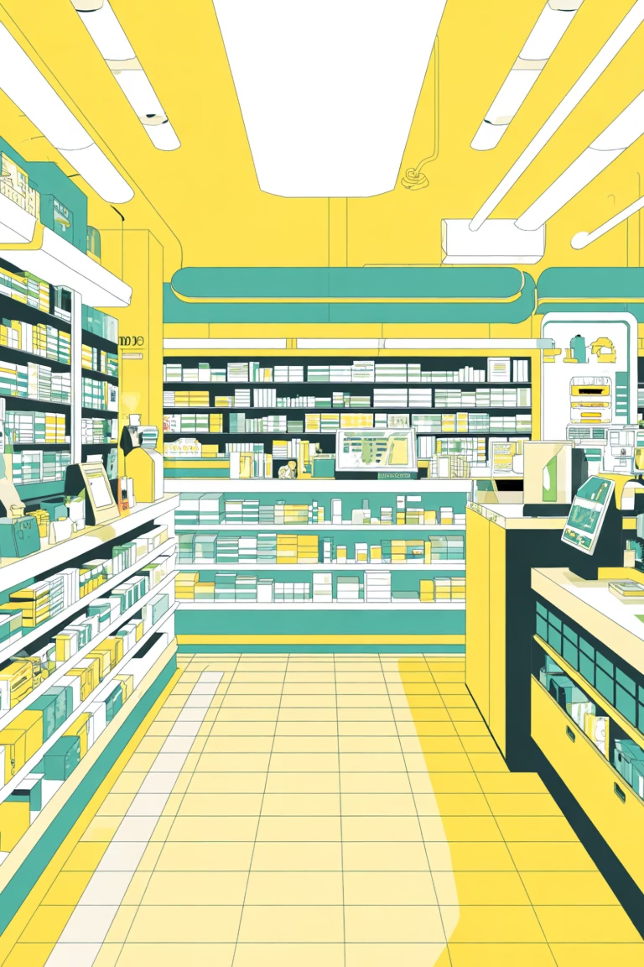
Pharmacy Management System
Course ID: ITDC0201
A comprehensive solution using C++ Object-Oriented Programming to streamline pharmacy operations and inventory management.
Presented To: Ms. Kusum Bharti
Presented By: Shashank Gupta & Rishu Kesharwani
(24124104) (24124095)

Slide 2
Presentation Outline
01
02
Motivation
System Design
Why pharmacy automation matters
Architecture and key features
03
04
OOP Concepts
Workflow
Core programming principles applied
Step-by-step system operation
05
06
Demo Output
Conclusion
Live system demonstration
Results and future enhancements

Slide 3

Motivation: The Need for Automation
Current Challenges
Manual Record-Keeping
Traditional paper-based systems are time-consuming, prone to human error, and difficult to maintain as inventory grows.
Stock Mismanagement
Poor inventory tracking leads to overstocking, shortages, expired medicines, and significant revenue loss.
Inefficient Operations
Slow billing processes and lack of real-time data create bottlenecks that frustrate customers and staff alike.
Solution: Automation dramatically improves accuracy, speed, and decision-making capabilities.

Slide 4





System Overview
Our Pharmacy Management System provides a comprehensive, modular solution for modern pharmaceutical
operations.
Medicine Database
Stores comprehensive medicine details including name, price, quantity, type, and manufacturing
information.
Inventory Management
Enables easy addition of new medicines and real-time updates to existing stock levels with validation.
Billing System
Automated price calculation, invoice generation, and transaction processing with tax computation.
Extensible Architecture
Modular OOP structure allows easy feature additions and system scalability as business needs evolve.

Slide 5




OOP Principles Applied
Demonstrating Core Object-Oriented Programming Concepts
Encapsulation
Inheritance
Private data members within classes protect sensitive information. Public methods provide controlled access to medicine details and inventory data.
Specialized medicine classes (Antibiotic, Painkiller) inherit common properties from the base Medicine class, promoting code reuse.
Polymorphism
Abstraction
The showDetails() method is overridden in derived classes, allowing type-specific behavior while maintaining a common interface.
Medicine serves as an abstract base class, defining the essential structure while hiding implementation complexity from users.

Slide 6
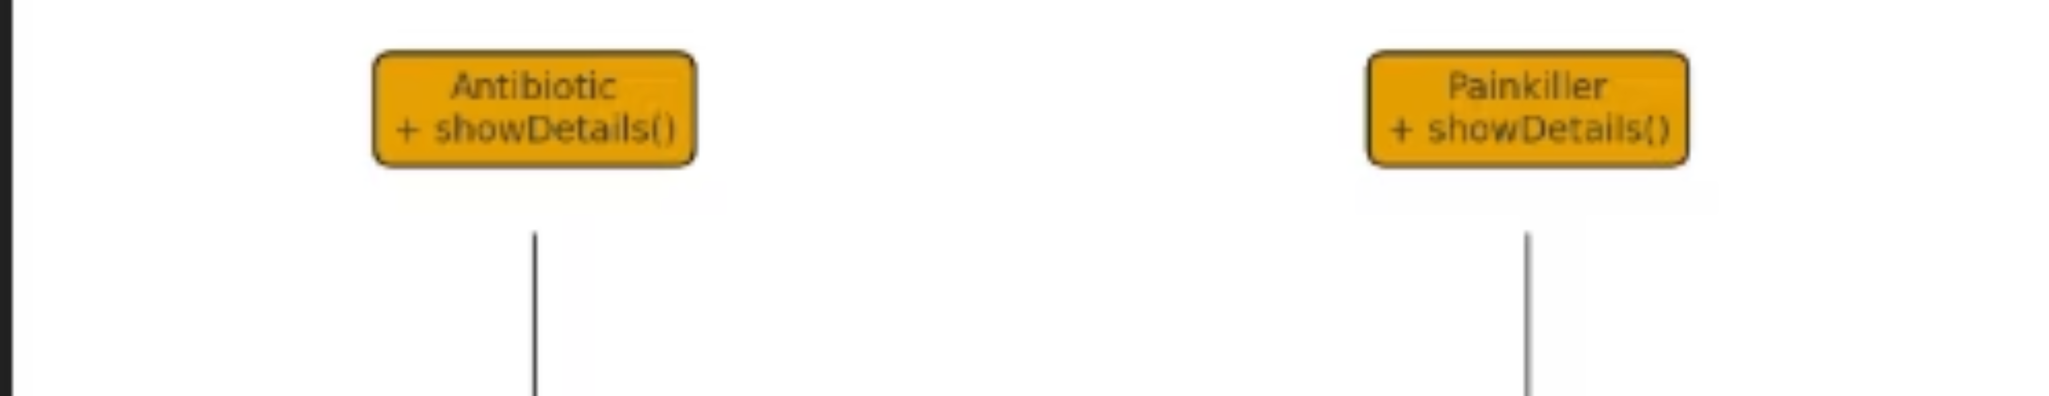
Class Hierarchy Architecture
The system's object-oriented design demonstrates a clean inheritance structure with the abstract Medicine class at its foundation.
Base Class
Derived Classes
The Medicine abstract class defines common attributes (name, price, quantity) and pure virtual functions that all derived classes must implement.
Antibiotic and Painkiller classes extend the base functionality, adding type-specific properties and behaviors through method overriding.

Slide 7



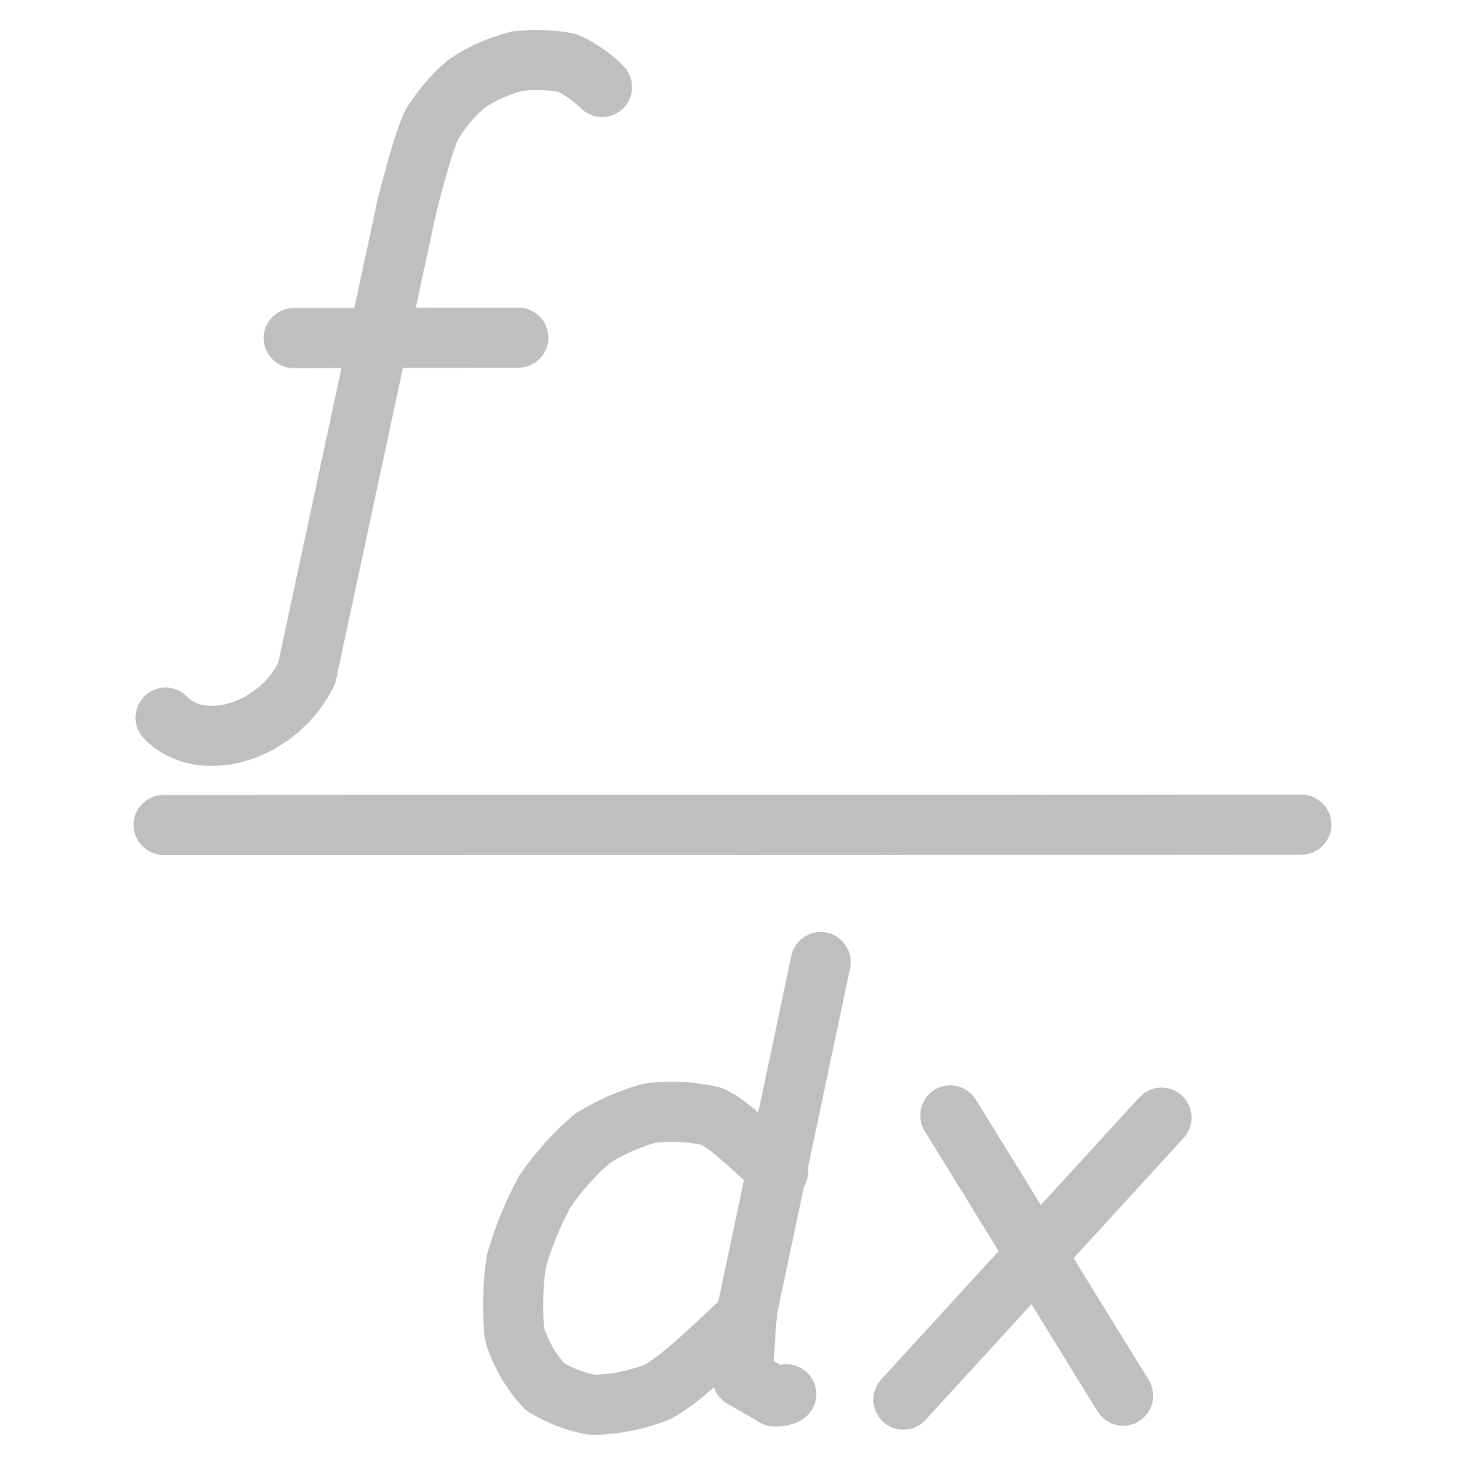

System Workflow
The pharmacy management system follows a streamlined process from inventory setup to transaction completion.
Add Medicines
Administrator inputs new medicine records with details like name, price, quantity, and category into the system inventory.
Display Inventory
System displays current stock with all medicine information, allowing pharmacists to view available products instantly.
Customer Purchase
Customer selects desired products from the inventory, specifying medicine name and quantity needed for purchase.
Bill Generation
System automatically calculates total cost, applies any discounts or taxes, and generates a detailed invoice for the transaction.
Stock Update
Inventory automatically adjusts quantities after each sale, maintaining accurate real-time stock levels and preventing overselling.

Slide 8
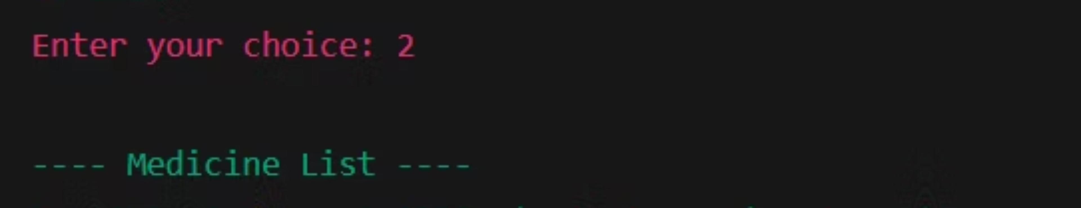
Sample Output: System in Action
Live demonstration showing the console-based interface and actual program execution with sample transactions.
Menu Interface
Data Entry
Output Display
User-friendly console menu with numbered options for all system operations.
Clean input prompts guide users through medicine registration and purchase flows.
Formatted tables and receipts present information clearly for easy readability.

Slide 9
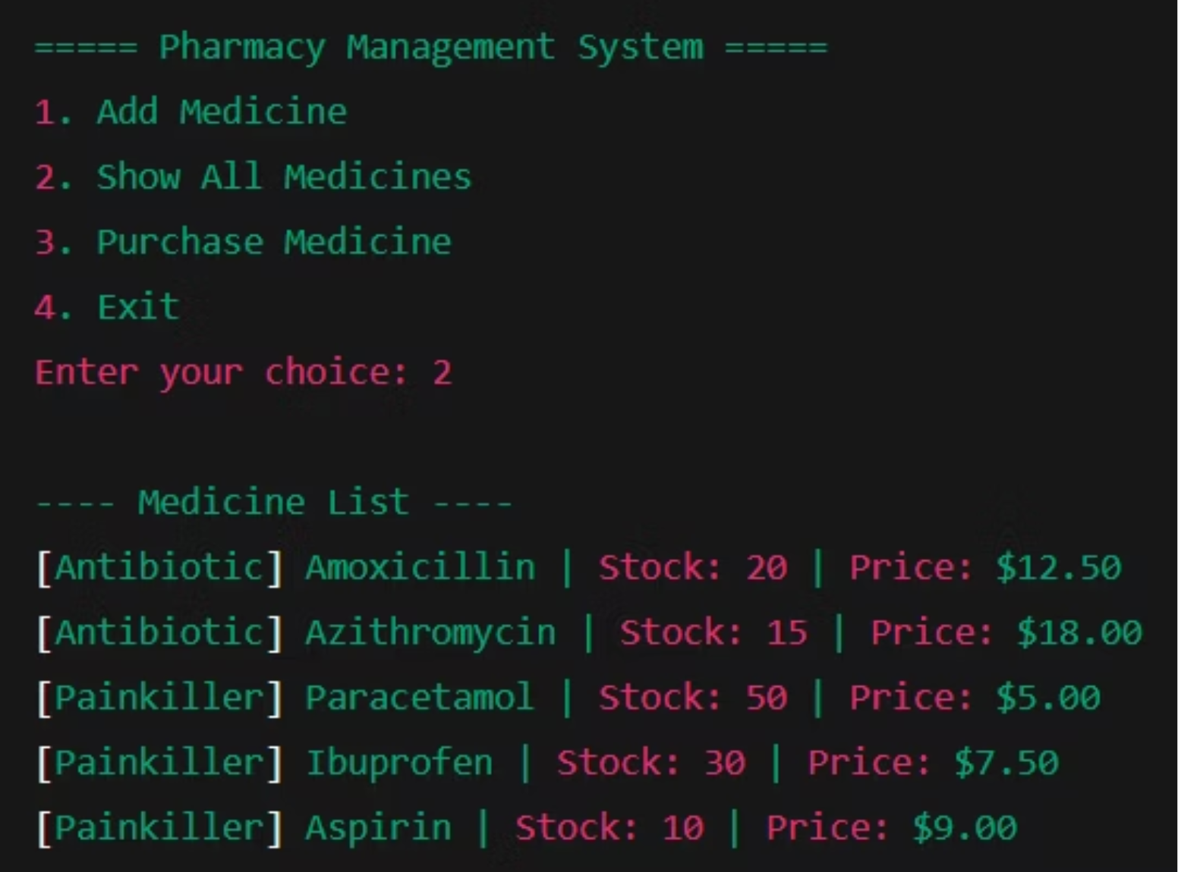
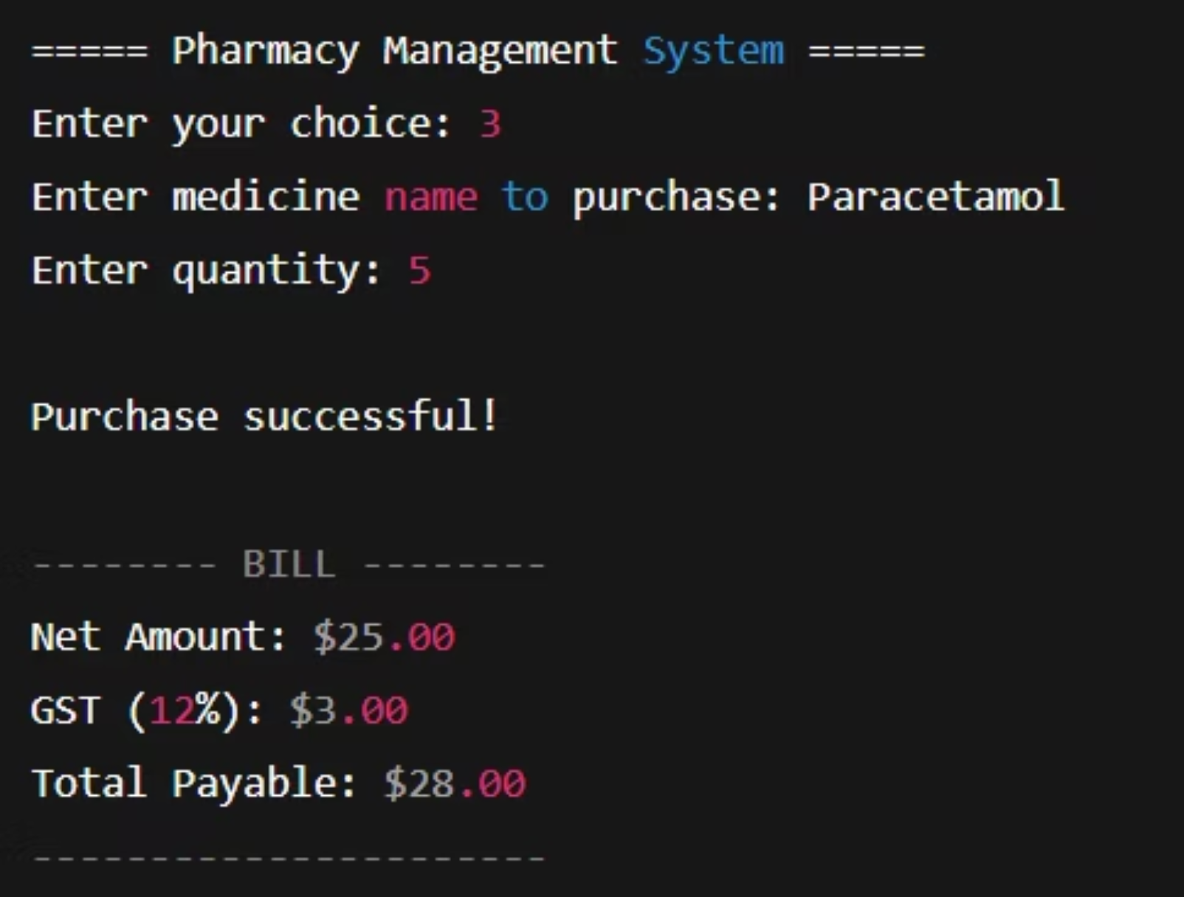
Output Generated

Slide 10
Detailed Output Examples
Inventory Display
Transaction Receipt
Complete medicine list showing all available products with their details, prices, and current stock quantities in a structured table format.
Generated bill showing purchased items, quantities, individual prices, subtotal, and final amount with clear transaction details for customer records.
The system demonstrates robust functionality through these real execution examples, showcasing data validation, error handling, and professional output formatting.

Slide 11
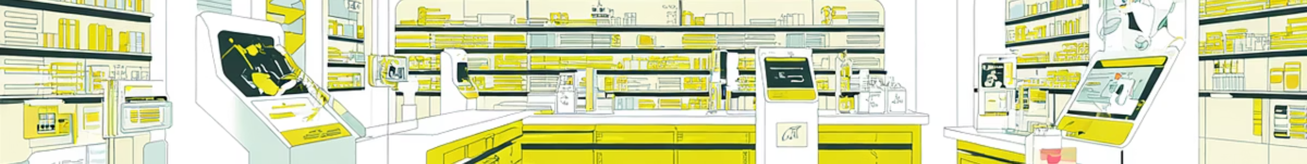




Future Enhancements
Planned improvements to expand system capabilities and prepare for production deployment.
Persistent Storage
Expiry Monitoring
Implement file-based or database storage (MySQL/SQLite) to maintain records across sessions and enable data backup and recovery.
Add expiration date tracking with automated alerts for medicines nearing expiry, reducing waste and ensuring patient safety.
Supplier Management
Barcode Integration
Track supplier information, purchase orders, and complete purchase history for better vendor relationships and procurement analytics.
Integrate POS barcode scanning hardware for faster checkout, reduced manual entry errors, and improved customer experience.
Vision: Transform this academic project into a full-featured, production-ready pharmacy management solution.

Slide 12
Conclusion
Fully automated basic pharmacy operations
Demonstrates essential OOP principles in C++
Highly scalable design

Slide 13
References
•C++ Standard Library Documentation
•Class lecture notes
• Object-Oriented Design best practices

